Slide 1
WORKING WITH FILES

Slide 2
INTRODUCTION
Computers have 2 types of memory.
Primary memory (temporary storage)
Secondary memory (permanent storage)
All programs which we have studied earlier
Inputs data from keyboard
Outputs results to the screen
We have utilised computers primary memory to store data, in t he form of variables, arrays, structure/class instances.
After the termination of program all the entered data is lost as it is stored on primary memory.

Slide 3
HOW TO STORE DATA PERMANENTLY?
Most real-time application needs to store data permanently, so that it can be used later, then it becomes necessary to keep it in permanent storage device.
To store the data in permanent form
We have to store the data on secondary storage.
On secondary storage data is stored in the form of files.

Slide 4
WHAT IS A FILE?
A file is a collection of bytes stored on a secondary storage device, which is generally a disk of some kind.
The collection of bytes may be interpreted, for example,
characters, words, lines, paragraphs from a text document;
fields and records belonging to a database; or
pixels from a graphical image.
We use files to store data which can be processed by our programs.
Not only data but our programs are also stored in files.

Slide 5
STREAMS
A c++ program can read or write data from/to a disk file.
Streams are used to communicate with disk files.

Slide 6
WHAT ARE STREAMS?
Streams are mediator between a C++ program & resources of various computer, such as
keyboard,
monitor,
disk files.
Streams are of 2 types
Input stream
Output stream
A Stream is internally nothing but a series of characters.

Slide 7
WHAT ARE STREAMS?
A stream is an abstraction that represents a device on which input and output operations were performed. A stream can basically be represented as a source or destination of characters of indefinite length.
Streams are generally destination of characters,
like a disk file,
the keyboard,
or the console,
associated to a physical source or
So the characters gotten or written streams are to/from physically input/output to the physical device.

Slide 8
WHAT ARE STREAMS?
We have already studied 2 standard input/output streams
cout
cin
cout is an output stream, which outputs data to the monitor.
cin is an input stream, which inputs data from keyboard.

Slide 9

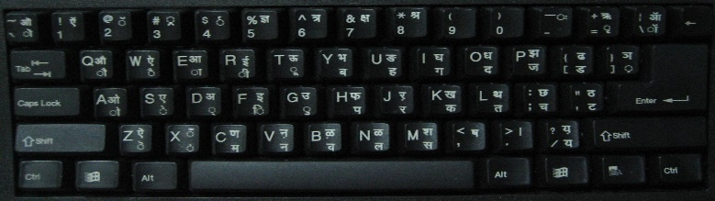
Internal Memory
PROGRAM + DATA
CIN>> (GET DATA FROM KEYBOARD)
Cout<< (PUT DATA TO SCREEN)
CONSOLE TO PROGRAM INTERACTION
Keyboard

Slide 10
External Memory
DATA FILES
PROGRAM FILE INTERACTION
read (READ DATA FROM FILE)
write (WRITE DATA TO FILE)
Internal Memory
PROGRAM + DATA
CIN>> (GET DATA FROM KEYBOARD)
Cout<< (PUT DATA TO SCREEN)
CONSOLE TO PROGRAM INTERACTION
Keyboard

Slide 11
WHAT ARE STREAMS?
We can define other streams as well (file streams)
Which redirects data to or from disk files
Can be used the same way as we have used cout & cin
Streams work with built-in data types, and you can make user- defined types work with streams by overloading the insertion operator (<<) to put objects into streams, and the extraction operator (>>) to read objects from streams.

Slide 12






File Streams
Programs can be designed to perform the read operations on these files.
File Streams are used to communicate with disk files.
and write
Write Data to
disk file
Output File Stream
C++
Program
Disk
Files
Input File Stream
Input data for
processing
Read Data
from disk file

Slide 13
File Streams
File Streams are of 2 types
Input file stream
Output file stream
Write Data to
disk file
Output File Stream
C++
Program
Disk
Files
Input File Stream
Input data for
processing
Read Data
from disk file

Slide 14
INPUT FILE STREAMS
Input file streams are used to input data from a disk file.
Input file streams supplies data from disk file to the program.
Write Data to
disk file
Output File Stream
C++
Program
Disk
Files
Input File Stream
Input data for
processing
Read Data
from disk file

Slide 15
Output file streams sends/writes data to the disk file.
Output File Streams
Write Data to
disk file
Output File Stream
C++
Program
Disk
Files
Input File Stream
Input data for
processing
Read Data
from disk file

Slide 16
INPUT/OUTPUT WITH FILES
C++ provides the following classes to perform output and input of characters to/from disk files:
ofstream
ifstream
fstream
: Stream class to write to files
: Stream class to read from files
: Stream class to both read and write from/to files.
To use these classes, we must include the <fstream> header file.

Slide 17
INPUT/OUTPUT WITH FILES
In C++, a stream is represented by an object of a particular stream class.
The stream class hierarchy is as follows
ios
istream
ostream
iostream
ifstream
fstream
ofstream

Slide 18
INPUT/OUTPUT WITH FILES
A Stream variable must be declared like any other class variable, for example,
ifstream myInputStream;
ofstream myOutputStream;

Slide 19
OPENING OF FILES
For opening a file we must first create a file stream and then link it to the filename. A filestream can be defined using the classes ifstream, ofstream, and fstream that are contained in the header file fstream.
The class to be used depends upon the purpose that is whether we want to read data from the file or we want to write data to file .
A file can be opened in two ways.
1. using the constructor of the class
2. using the member function open( ) of the class

Slide 20
OPENEING FILES USING OPEN( )
Once stream object has been declared, we must connect it to a physical disk file,
In order to open a file with a stream object we use its member function open().
StreamObject.open (FileName, [Mode]);

Slide 21
OPENEING FILES USING OPEN( )
StreamObject.open (FileName, [Mode]);
Open method has 2 parameters
FileName Mode
: name/full path of physical disk file to be opened
: purpose for opening a file, (Reading/Writing)
The mode parameter is optional for ifstream & ofstream, as ifstream implicitly means input mode, and ofstream implicitly means output mode, for a fstream object both parameters are necessary.

Slide 22
Various Modes for Opening File
Mode is an optional parameter with a combination following flags:
of the
ios :: in | Open file for input operations.
ios :: out | Open file for output operations.
ios :: binary | Open in binary mode.
ios :: ate | Set the initial position at the end of the file. If this flag is not set, the initial position is the beginning of the file.
ios :: app | All output operations are performed at the end of the file, appending the content to the current content of the file.
ios :: trunc | If the file is opened for output operations and it already existed, its previous content is deleted and replaced by the new one.

Slide 23
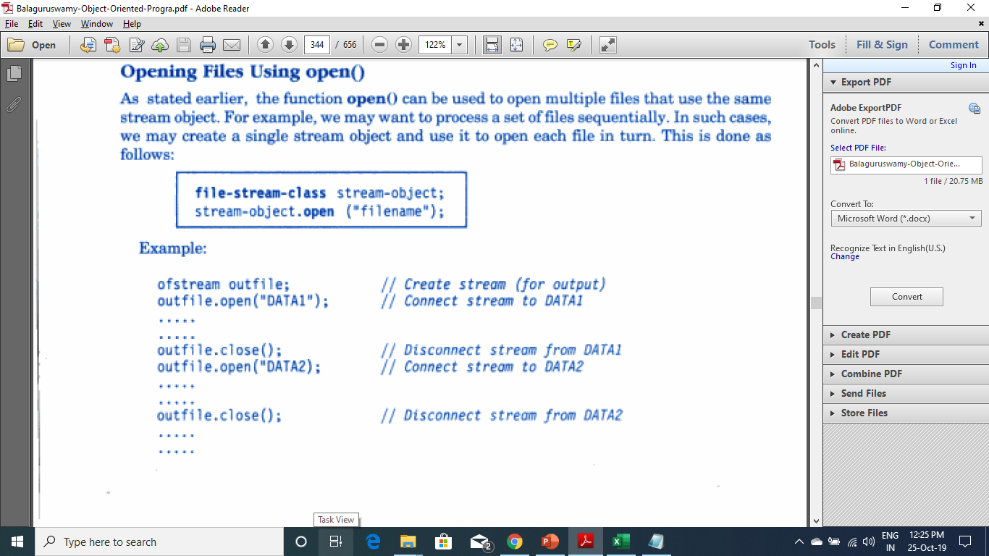
OPENEING FILES USING OPEN( )

Slide 24
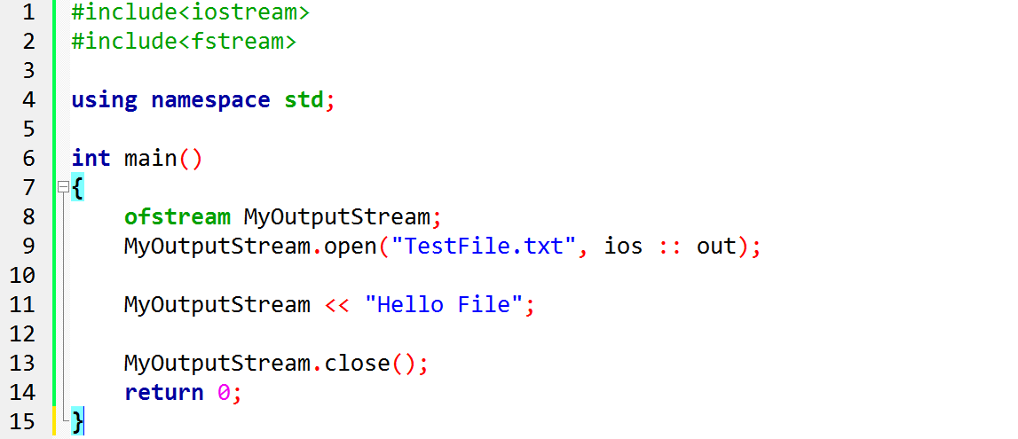
Once declared we can use file streams normally in the same fashion we have used cout and cin streams.
Writing data to Files (file output)

Slide 25
This code creates a file called TestFile.txt and inserts a sentence into it, the same way we are used to do with cout, but using the file stream MyOutputStream instead.
Writing data to Files (file output)

Slide 26
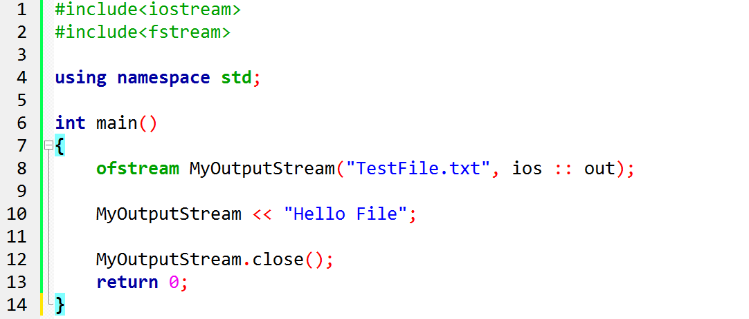
Filename & mode can be provided to the constructor of stream class, instead of calling open() method explicitly.
Writing data to Files (file output)

Slide 27
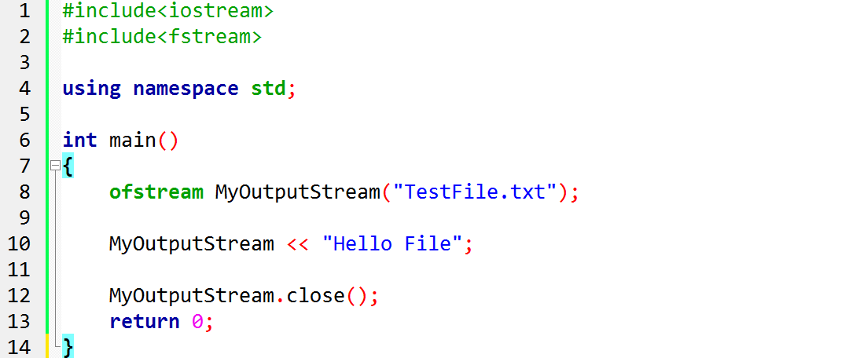
As we know mode is optional for ofstream and ifstream, so its not necessary to specify it. Specify only file name to be open
Writing data to Files (file output)

Slide 28


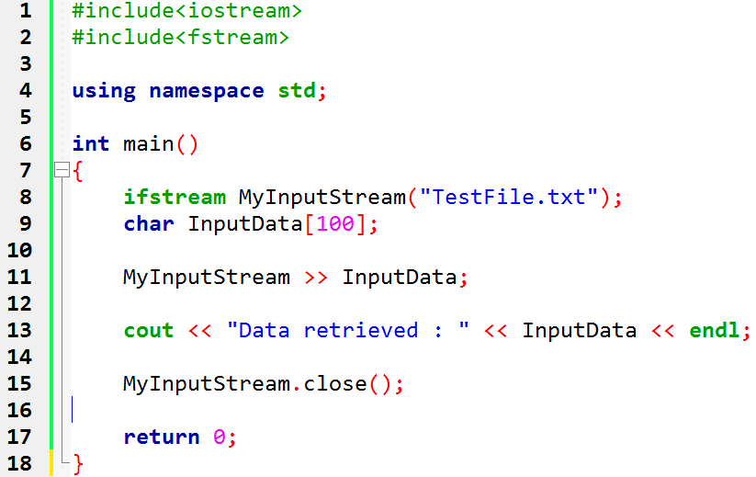
Reading data from Files (file input)
Data can be retrieved from a file input stream the same way we
read from standard input stream ‘cin’.
Output
Data Retrieved : Hello File

Slide 29
#include<iostream>
#include<fstream>
#include<string>
using namespace std;
int main()
{
ofstream myoutfile("textfile.txt");
myoutfile<<"hello this is a file program “;
myoutfile.close();
ifstream myinfile("textfile.txt");
char ch[80];
myinfile.getline(ch,80);
cout<<"output from file is:=="<<ch<<endl;
myinfile.close();
return 0;
}

Slide 30
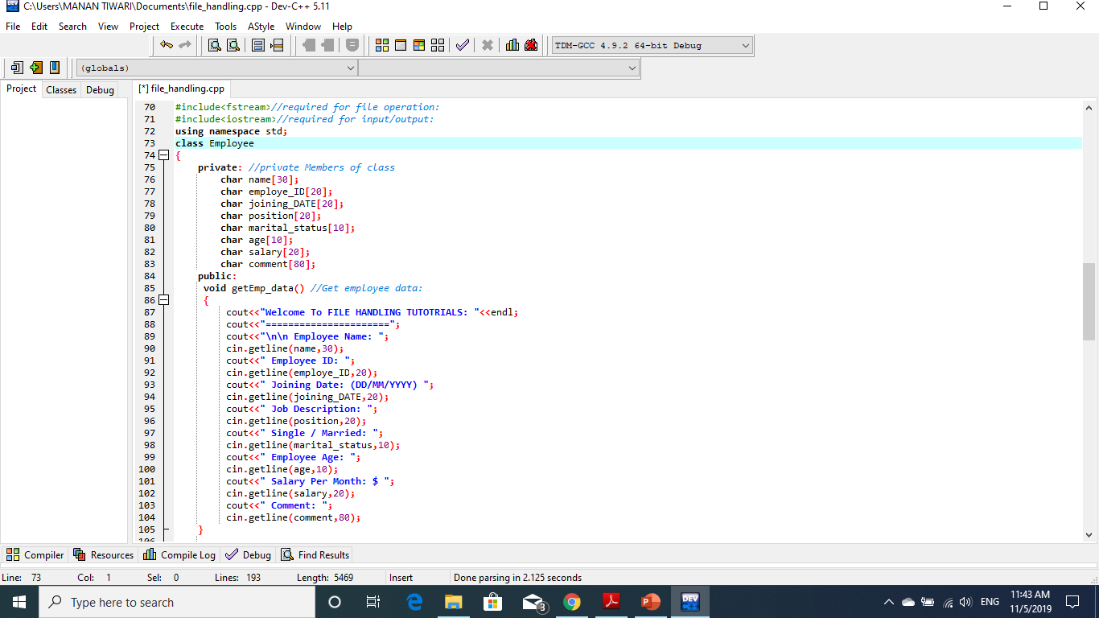

Slide 31
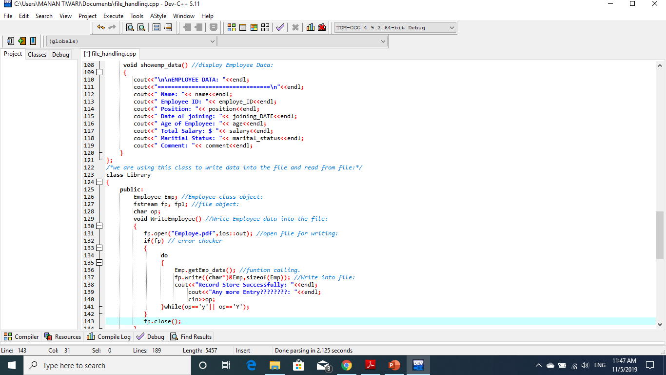

Slide 32
